Slide 1
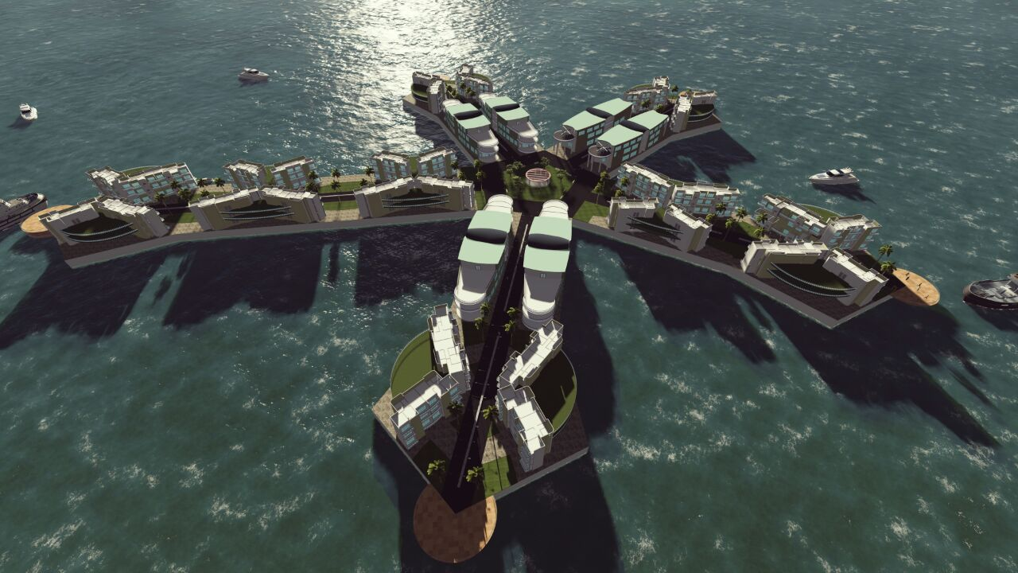
1
Floating city design
Reg.no1030

Slide 2
2
Concept- Lotus flower
The site platform was evolved from the petals and arrangement of Lotus Flower.
A core open space platform connects all the other branches and provides a Centre of activity.
This particular pattern allows residential blocks to disconnect easily without disturbing the other platforms.
Concept
Evolution of design
Floating city design
Reg.no1030

Slide 3
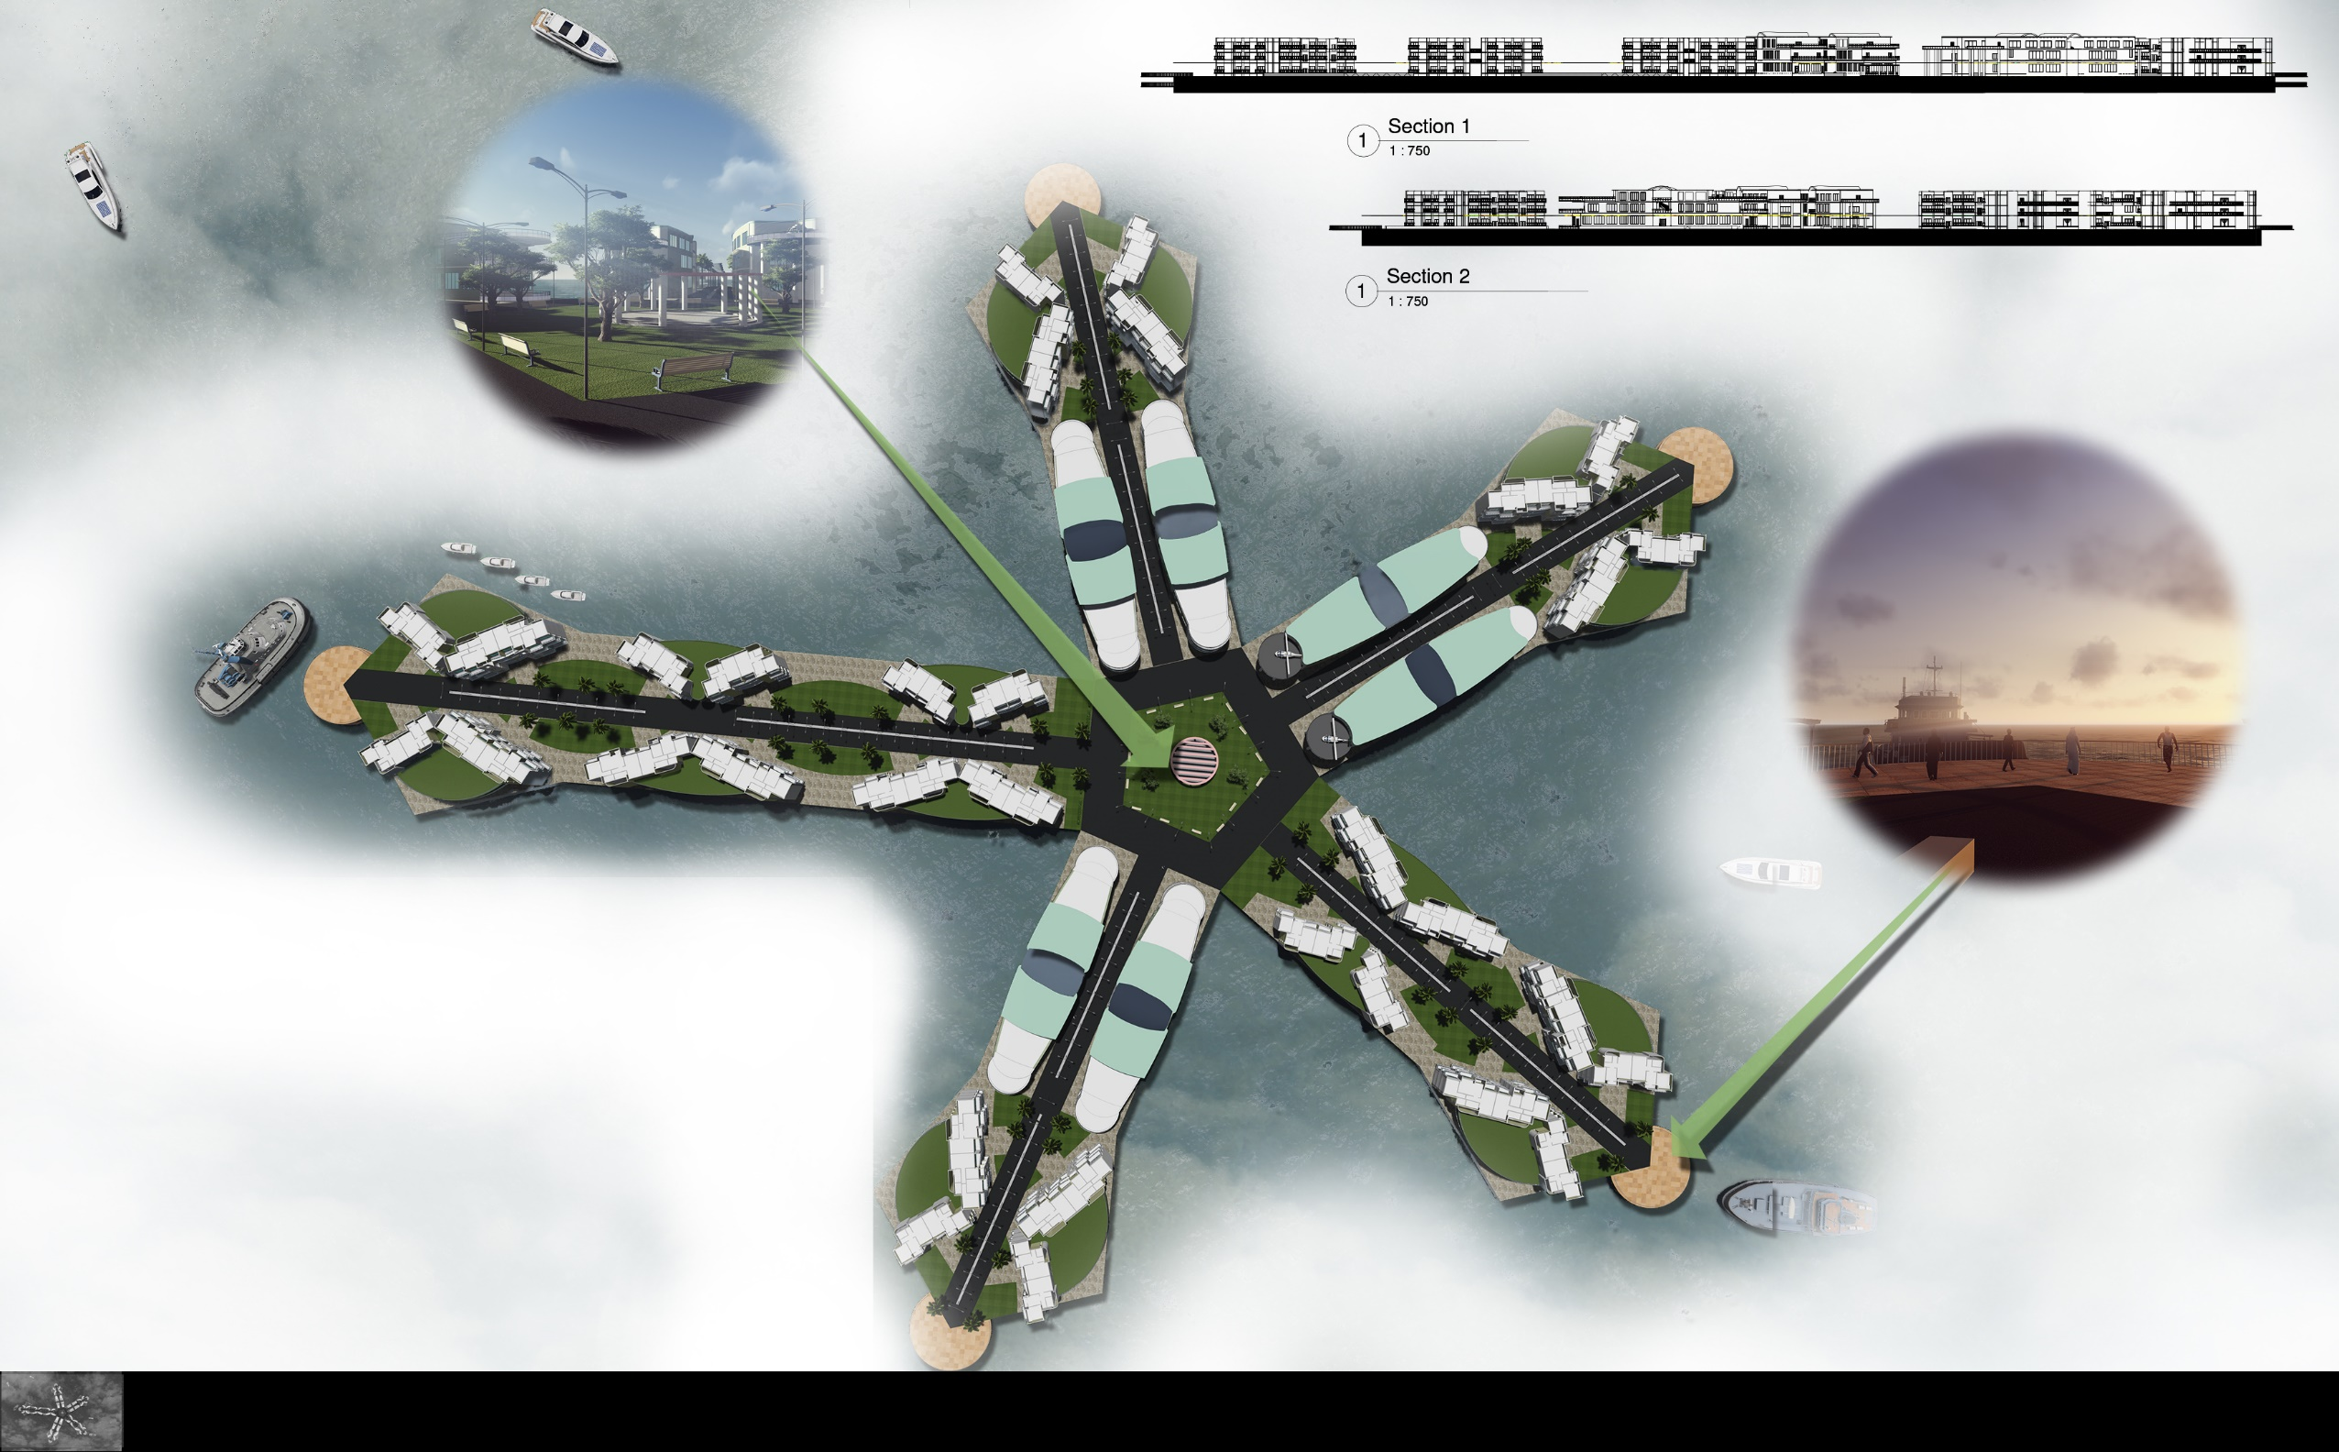
3
Site layout
The site platform was evolved from the petals and arrangement of Lotus Flower.
Floating city design
Reg.no1030

Slide 4
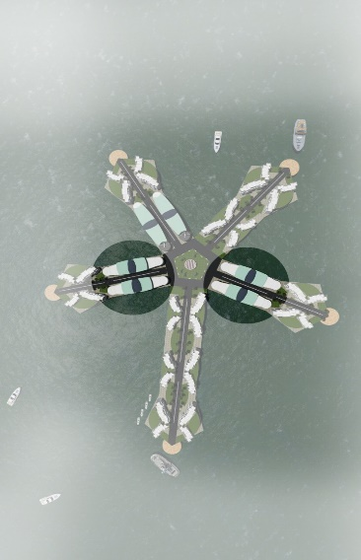
RECEPTION CUM WAITING AREA
STAIRCASE WITH RAMP
STAFF OFFICE
GENTS & LADIES TOILET
DIRECTOR OFFICE
AC ROOM
CONFERRENCE ROOM
TERRACE LANDSCAPING
4
A
4
3
3
3
3
3
3
4
A’
2
8
8
7
7
8
8
4
5
3
3
1
3
3
5
4
6
6
FLOOR PLAN OF OFFICE BLOCK
Office Block
KEY PLAN
SECTION AA’
Floating city design
Reg.no1030

Slide 5
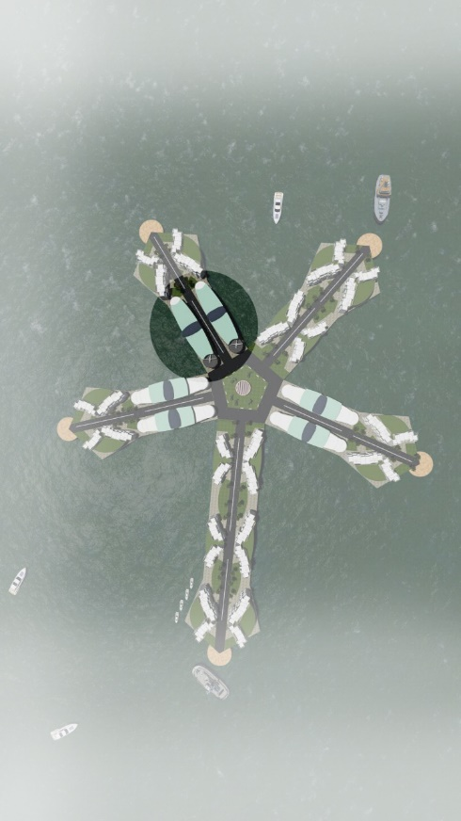
RECEPTION CUM WAITING AREA
STAIRCASE WITH RAMP
RESTAURANT SEATING AREA
KITCHEN AREA
TERRACE LANDSCAPING & HELEPAD
5
B
B’
5
2
5
4
3
3
4
1
FLOOR PLAN OF HOTEL BLOCK
Hotel Block
KEY PLAN
SECTION BB’
Floating city design
Reg.no1030

Slide 6
6
C
C’
KEY PLAN
VIEW
TYPICAL FLOOR PLAN ON RECTANGULAR PLATFORM
C
C’
SECTION
Residential Block
TYPICAL FLOOR PLAN ON PENTAGON PLATFORM
VIEW
VIEW
Floating city design
Reg.no1030

Slide 7
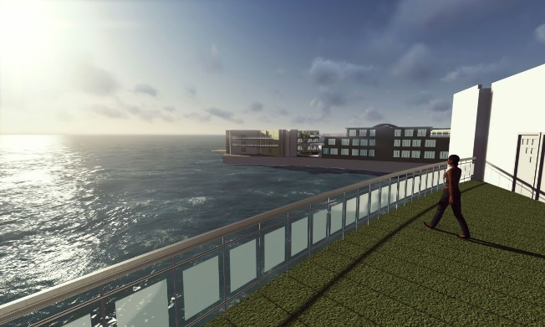
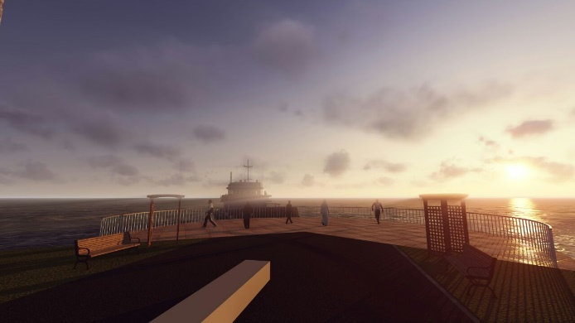
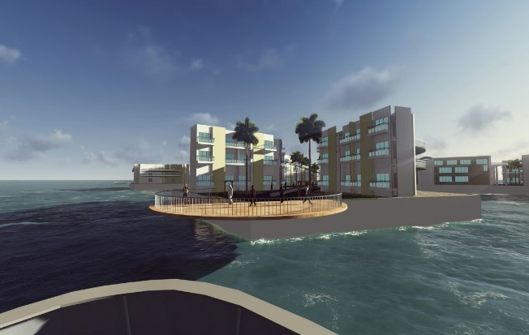
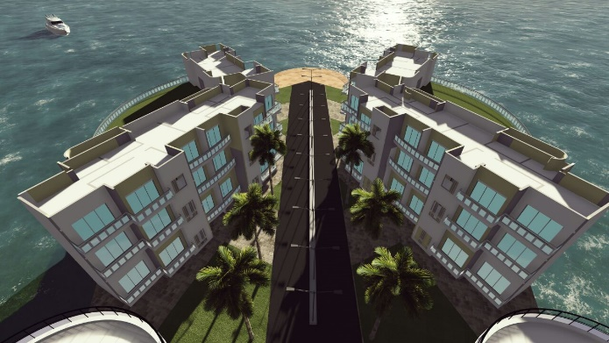
7
Slide View
Residential Terrace View
Views
Aerial view of Floating City
Deck View
Residential Bird’s Eye View
Floating city design
Reg.no1030
Reg.no1030

Slide 8
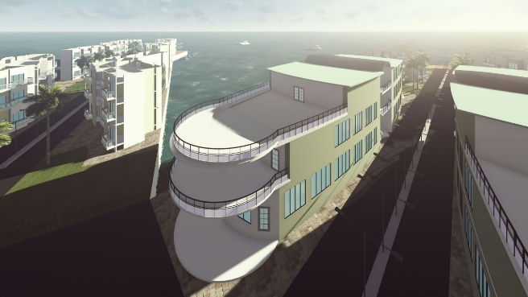
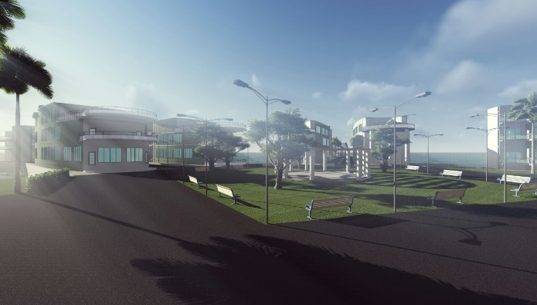
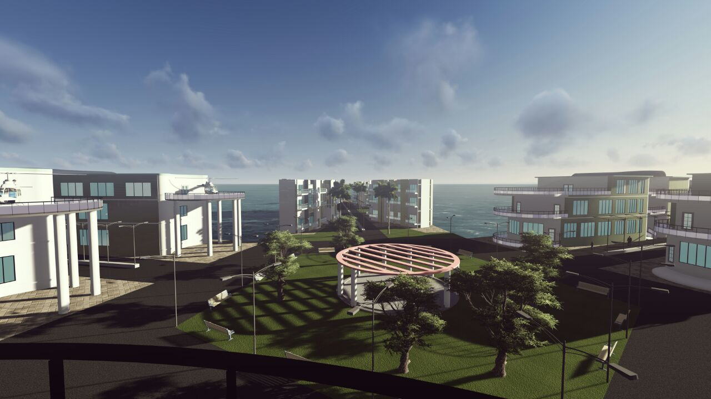
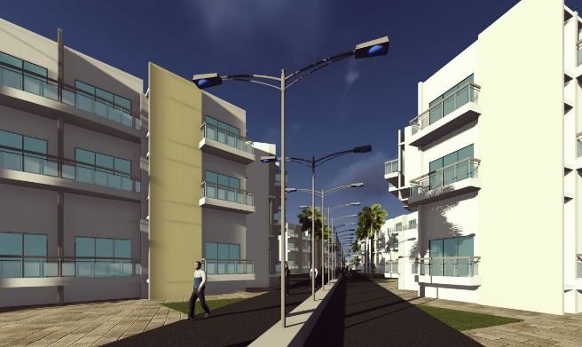
8
Top view of Office Block
Street View
Views
Central Landscape View
Residential Street View
Residential Bird’s Eye View
Floating city design
Floating city design
Reg.no1030
Reg.no1030

